Slide 1
Review Class 2
Kazi Amit Hasan

Slide 2
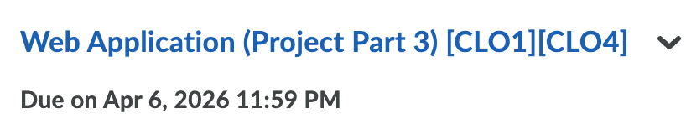
Upcoming schedule
April 6th >>
- Final exam: April 12, 2026

Slide 3
What we have covered so far
Introduction to Database and ER models
Relational models
Translation from ER to Relational
Relational Algebra
SQL
Application development
Storage and indexing
Security
NoSQL

Slide 4
Final Exam Format
Three sections
Multiple choice, true/false and short answers: 15 marks
ER diagrams: 10 marks
Query language: 20 marks

Slide 5

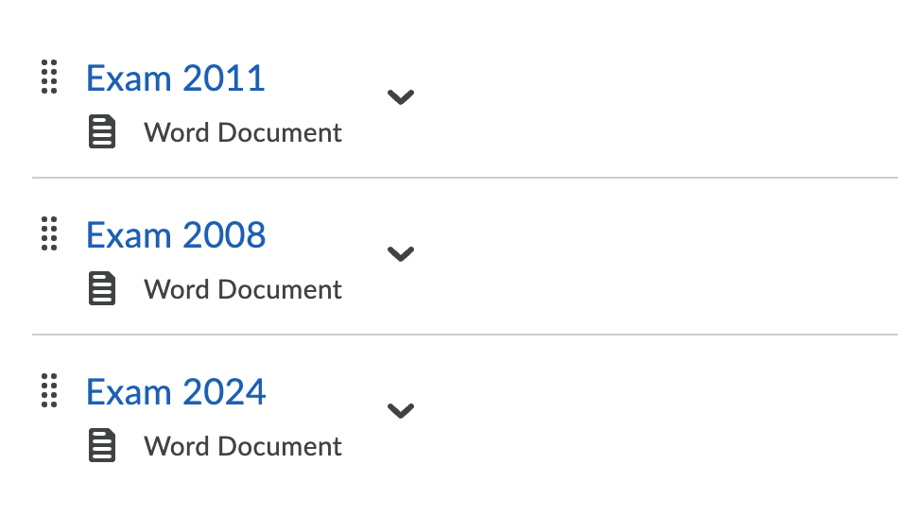
Sample Questions

Slide 6
MUST do things
ER diagrams
Careful while selecting the keys
READ question multiple times
You must denote the weak entity. If you forcefully make a weak entity to strong by assuming primary key. Marks will be deducted!
Careful with the shapes. Weak entities are different than regular entities.
Solve all solved examples in the class again

Slide 7
MUST do things
SQL queries:
Must read the questions
Must solve all solved problems in the class.
Must solve all previous year questions

Slide 8
MUST do things
Relational Algebra:
Must read the questions
Must solve all solved problems in the class.
Must solve all previous year questions

Slide 9
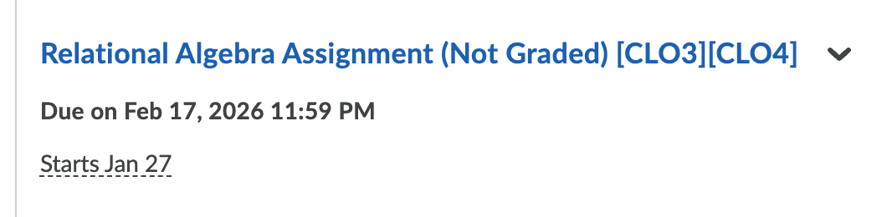
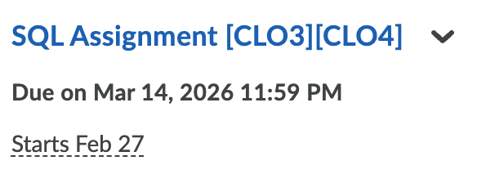
Must do things
Solve the ungraded assignments

Slide 10
Others
If anyone needs any LOR in future, you can email me at kaziamit.hasan@queensu.ca

Slide 11
Thank you

